Slide 1


“Home Team Tracker”
An intuitive set of CRM tools that allows even the newest fundraiser to better manage their relationships.
DANNY BURNS
Senior Director of Technology Integration
Fellowship of Christian Athletes

Slide 2
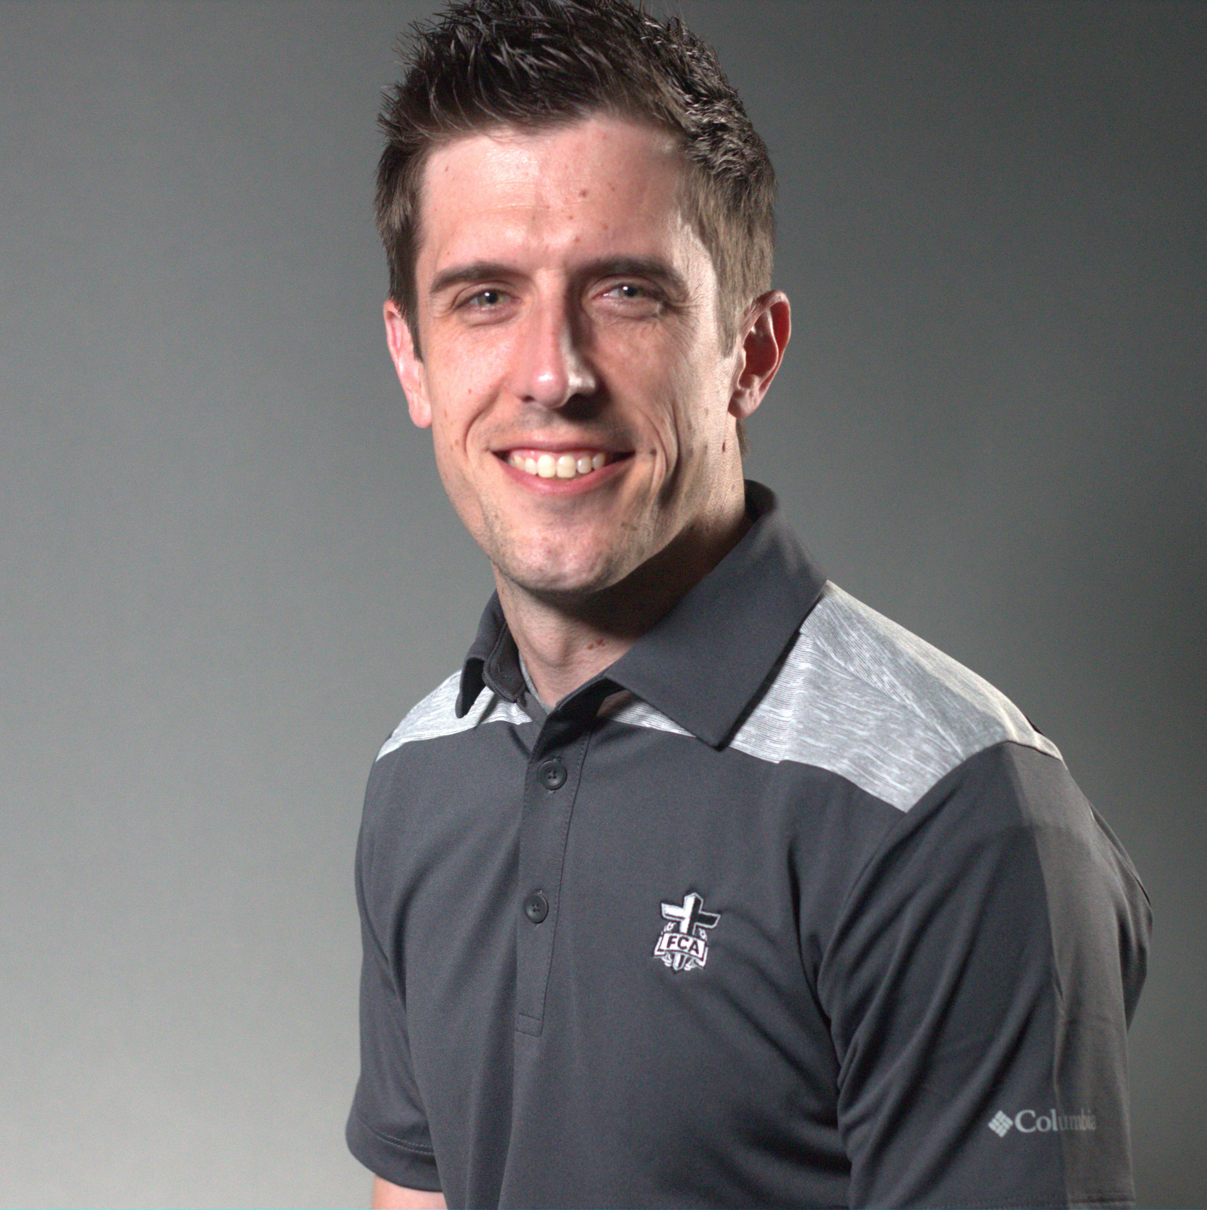
Danny Burns
linkedin.com/in/dannyburns
Sr. Director of Technology Integration
AT FCA
15 years
Kansas City, Missouri
Help advance the ministry of FCA by focusing on designing, developing and deploying innovative technology solutions that integrate with the organization's current infrastructure. Love the Chiefs, praying for the Royals. :-)

Slide 3
The Background
2000+ extremely decentralized staff across the country with various technology proficiency
Each new staff must raise funds before they are officially hired
We provide great fundraising training, but no modern tools
Given a 15-year-old spreadsheet template called “Home Team Tracker” to track contacts, engagement, asks and donations
BBCRM doesn’t have a fully functional mobile version OTB
Prospecting Module in BBCRM is “heavy” and designed for “major gift officers” not local FCA staff who have many roles (fundraiser, event organizer, mentor, speaker, coach, volunteer manager, etc.)

Slide 4
The Challenge
How do we provide a powerful set of tools for the new staff person that is feature-rich, simple and intuitive?
How do we allow visibility to their supervisor for ongoing accountability and coaching?
How do we solve for the mobile issue as our staff will not be in front of a laptop for most of the day?

Slide 5
The Solution
Leverage OTB CRM functionality when possible
Research Lists
Prospect Module
Widgets
Add some custom data structures
Extend/customize add/edit forms
Create custom page views, datalists, listbuilders
Extend open-source “Fundraiser on the Go” (FROG) for a mobile companion allowing staff to record interactions on the go

Slide 6
How We Rolled = Agile!
Assembled a team of 15 staff from across the country in various roles
Created a sub-group (Technical Team) of 5 power users
Allowed large team to speak into requirements and provided them weekly updates
Technical Team worked iteratively with our developer and product owner in agile approach.
Weekly > Define the work > Do the work > Demo the work > Repeat
Prototype available in a month, beta version available in two months to pilot group, version 1 available to larger pilot by third month. All with 1 developer!
Used ZenDesk to gather feedback, fixed bugs, prioritized enhancements

Slide 7
TEST DRIVE

Slide 8
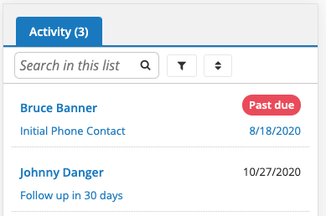
Home Team Tracker Mobile Companion

Slide 9
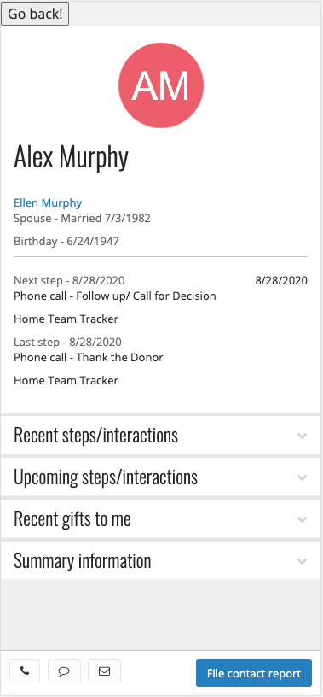

Slide 10
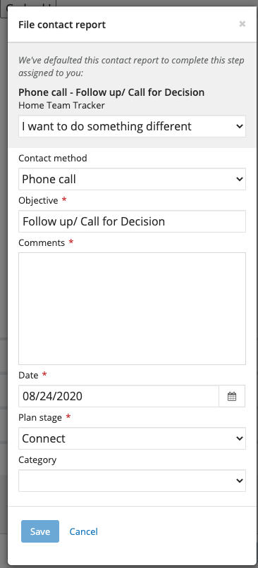

Slide 11
The Win
New staff now have a powerful yet intuitive tool to steward their donor relationships.
Data is retained inside BBCRM and not in hundreds of spreadsheets. We actually are building the infamous “360 degree” view of a person’s relationship with our organization.
For the first time ever we have a view into our staff’s decentralized fundraising efforts from the highest level.
Increased accountability and coaching at the local level
Delivered a basic mobile solution for task/step management

Slide 12
Beyond
We will enable Home Team Tracker for existing staff so everyone can use it to manage their donor relationships.
We now have the foundation to leverage Home Team Tracker beyond donors as we help our staff steward over their relationships with coaches, athletes and volunteers.

Slide 13

@dannygburns
linkedin.com/in/dannyburns

Slide 14



